Slide 1
Varying planetary heat sink led to global-warming slowdown and acceleration
Submitted To:
Prof. Saurabh Rathore
Submitted By:
Himani(2023AST2527)
Nirbhay(2011PH10855)
Riddhidipta(2021CS10546)

Slide 2
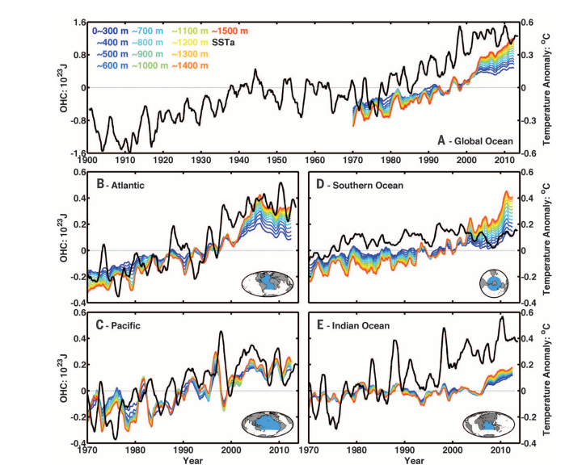
Analysis of Ocean Heat Content (OHC) and Temperature Anomalies
Fig. 1

Slide 3
Analysis of Ocean Heat Content (OHC) and Temperature Anomalies
Overview - SST & OHC analysis (1990s- 2013)
Global Ocean : steady increase in OHC, with direct correlation with SST rise.
Atlantic Ocean : strongly correlated variability in OHC and SST; post 1970
Pacific Ocean : decadal oscillations and long-term trends over OHC and SST interaction
Southern Ocean : strongly correlated increase in OHC and SST at all depth levels, a significant heat uptake
Indian Ocean : accelerating rise in OHC and SST, an increased heat retention
Implications
Oceanic basins presenting a distinct pattern of heat retention and release
Increasing heat sink behavior visible at deeper oceanic layers
Ocean-Climate interactions present extensive regional variability

Slide 4
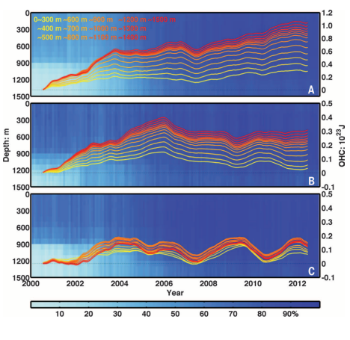
In Situ Data Coverage and Ocean Heat Content Variability
Fig. 2

Slide 5
In Situ Data Coverage and Ocean Heat Content Variability
Overview - Heat Content Analysis
Global Ocean : Increased heat content, especially at shallower depths
Atlantic Ocean : Notable mid-depth heat variability
Pacific Ocean : Distinct mid-depth heat patterns; stable at surface and deeper levels
Implications
Consistent rise in ocean heat content across all depths since 2000.
Data indicates increasing oceanic heat absorption, critical for climate analysis.
The anomalies are relative to year 2000, showing change over time without baseline climatology.

Slide 6
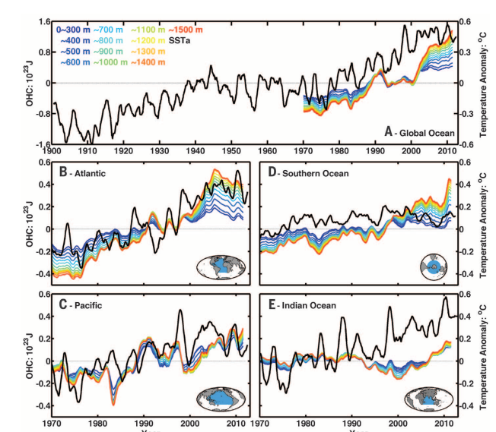
ORAS4 Reanalysis of Ocean Heat Content and SST Anomalies
Fig. 3

Slide 7
ORAS4 Reanalysis of Ocean Heat Content and SST Anomalies
Overview: Global and Regional
Global Ocean : Rising OHC trends, with recent decades showing elevated heat storage at multiple depths.
Atlantic Ocean : High variability and sharp increase in OHC coincide with significant SST anomalies.
Pacific Ocean : Varied OHC levels, displaying both short-term fluctuations and long-term warming trends.
Southern Ocean : Consistent upward trend in OHC with a notable recent increase in SST anomalies.
Indian Ocean : Steady growth in OHC and SST anomalies, particularly in the 21st century.

Slide 8
ORAS4 Reanalysis of Ocean Heat Content and SST Anomalies
Implications
ORAS4 reanalysis provides a more accurate representation of OHC and SST variations.
Color bands indicate depth-specific heat content changes, while black lines show SST anomalies.
Enhanced understanding of heat distribution in ocean depths.
Underlines the importance of oceanic heat in global climate dynamics.
ORAS4 data improves historical comparisons and aids in the analysis of long-term climate patterns.

Slide 9
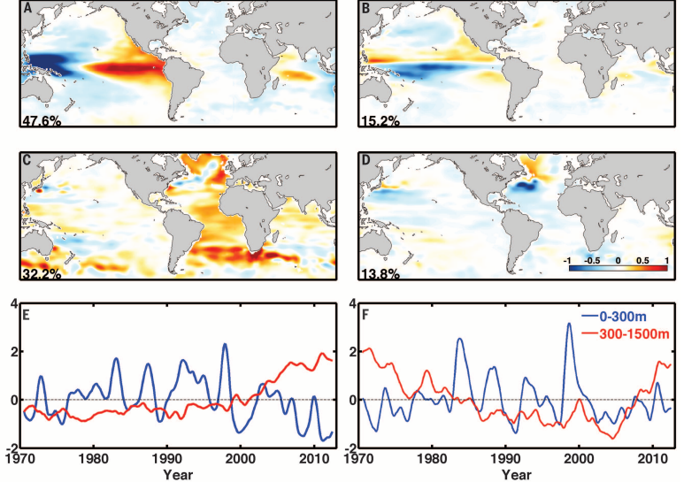
Empirical Orthogonal Function Analysis of Ocean Heat Content
Fig. 4

Slide 10
Empirical Orthogonal Function Analysis of Ocean Heat Content
The graphs provide insights into how different ocean depths contribute to heat content changes, crucial for projecting future climate scenarios.
Spatial Heat Content Patterns
Upper 300m (A&B): Strongest variations in the tropical Pacific, aligning with ENSO dynamics.
300-1500m (C&D): Marked warming in the Atlantic and around the Antarctic Circumpolar Current.
Variability Explained
Upper 300m (A): 47.6% of the variability, indicating significant influence of surface processes.
300-1500m (C): 32.2% of the variability, suggesting deep ocean processes play a substantial role.

Slide 11
Empirical Orthogonal Function Analysis of Ocean Heat Content
Temporal Trends
Upper 300m (E - Blue Line): Shows oscillating pattern reflecting short-term climate variations such as ENSO.
300-1500m (F - Red Line): Indicates a long-term warming trend with less pronounced oscillations.
Implications
The first EOF captures the dominant mode of ocean heat content variability, with significant implications for understanding ocean heat uptake and its influence on global climate patterns.

Slide 12
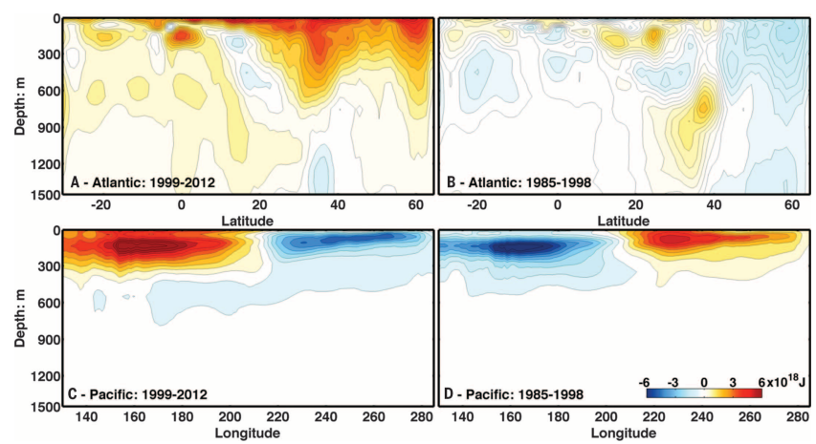
Ocean Heat Content Variation in the Atlantic and Pacific
Fig. 5

Slide 13
Ocean Heat Content Variation in the Atlantic and Pacific
Changes in heat content are critical indicators of oceanic contributions to global climate dynamics, with implications for understanding climate change trends.
Atlantic Ocean Heat Trends
Recent Period (A: 1999-2012): Significant heat content increase at various depths, notably between the equator and 40°N.
Earlier Period (B: 1985-1998): More moderate changes in heat content, less depth penetration.
Pacific Ocean Heat Trends
Recent Period (C: 1999-2012): Pronounced heat content increase at shallow depths, especially around the equator.
Earlier Period (D: 1985-1998): Variability in heat content with less clear pattern, particularly at deeper levels.

Slide 14
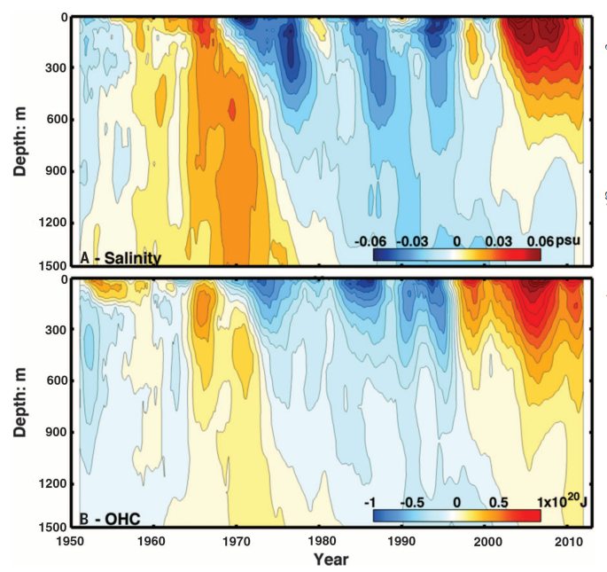
Salinity's Influence on Deep Ocean Heat Content
Fig. 6

Slide 15
Salinity's Influence on Deep Ocean Heat Content
Understanding these patterns is crucial for climate prediction and highlights the importance of salinity in ocean heat dynamics and its wider climatic impacts.
Salinity Trends (A)
Positive salinity anomalies in the North Atlantic have rapidly extended to 1500m in the 21st century, reaching levels unprecedented since records began.
Contrast with previous decades' negative anomalies aligns with shifts from rapid surface warming to a warming hiatus.
Ocean Heat Content (B)
OHC increases correspond with periods of positive salinity anomalies, suggesting deep convection as a key mechanism.
The trend of increasing OHC with salinity changes underscores the importance of salinity in the ocean heat uptake and storage.

Slide 16
Salinity's Influence on Deep Ocean Heat Content
Long-term Perspective
Historical view since 1950 shows salinity and OHC cycles correlating with climate shifts, indicating a multi-decadal pattern of variability
Climate Implications
Salinity changes in the subpolar North Atlantic likely trigger shifts in deep-water formation and ocean circulation, affecting global climate patterns
This cycle suggests a natural variability that operates alongside anthropogenic influences on the climate system

